Slide 1
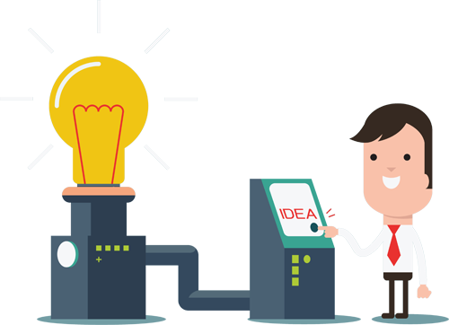
The Global Treps Project
Anyone can be an entrepreneur

Slide 2

Global Treps Project Recall
Promote Entrepreneurism
Market Your Idea
Market Yourself

Slide 3

Project Recap
Templates and guidelines for running events
Visual and audio resources
Aid for other organizations to build from our ideas
To accept donations towards schools and organizations to host their own event

Slide 4
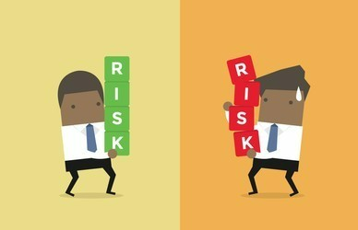
Planning Risk Management
Planning risk management is the process of deciding how to approach risk management activities and plan for them in a project; the main output of this process is a risk management plan.

Slide 5
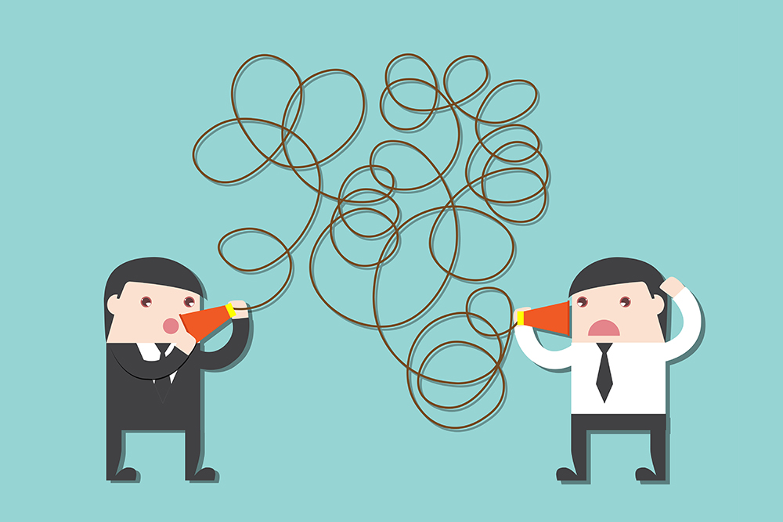
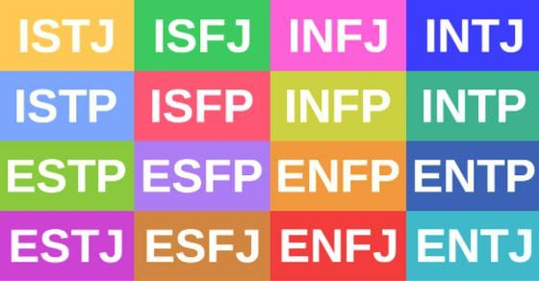
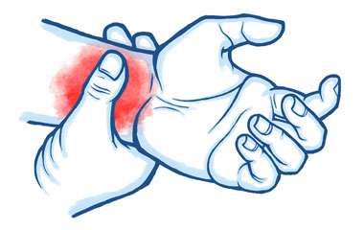
Possible Future Risks
Bad Communication
Injuries/Accidents
Different Personalities

Slide 6
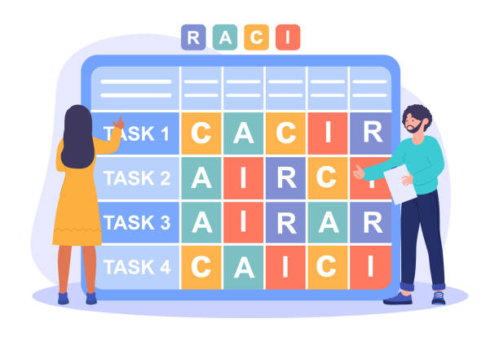
R
A
C
I
esponsibility
ccountability
onsultation
nformed

Slide 7
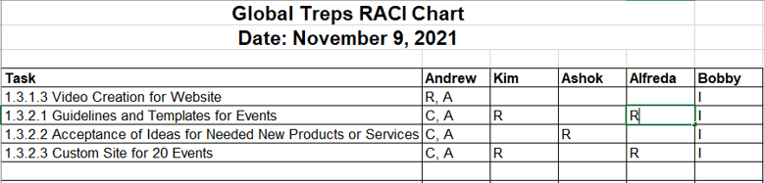
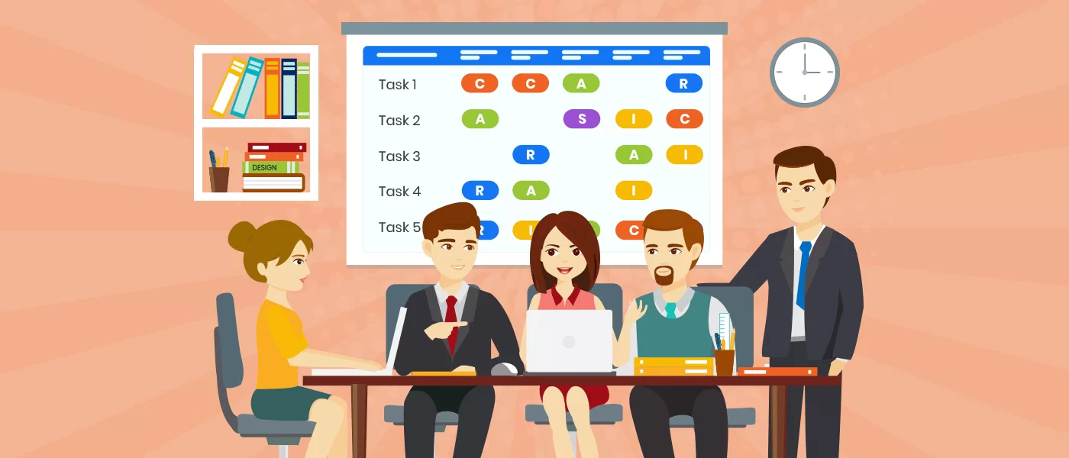
Who’s In Charge of What?

Slide 8
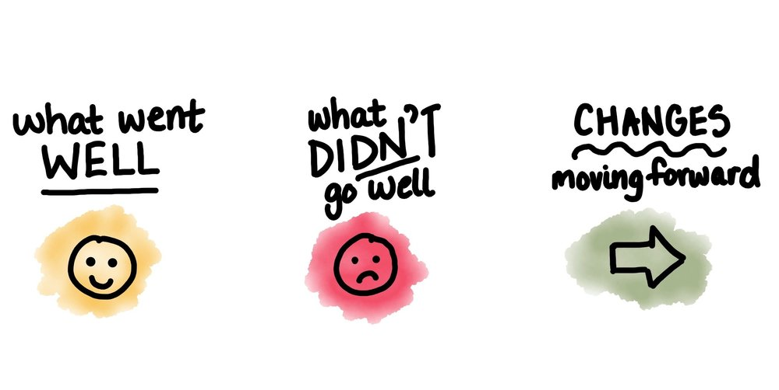
Final Steps

Slide 9
Thank You!
From The Global Treps Team

